Slide 1

Customer Retention analysis Using Real-Time Review Scraping and Machine Learning
Presented by:
Venkata Sahith Thiruckovalluru.
Venkata Pranathi Yammanuru.
Nikhitha Pochimireddy.
Sai Cherith Brahmadevara

Slide 2
Problem Statement:
Customer churn is a major business problem.
Traditional churn prediction relies on structured data like customer age, location, purchase history.
Our approach: Using unstructured customer reviews as a powerful additional signal.
Aim: Automate churn prediction from reviews using Natural Language Processing (NLP) + Machine Learning (ML) in an end-to-end pipeline.
Dataset: Trustpilot reviews from Flipkart, Amazon etc
Project overview
Developed an end-to-end system to predict customer churn using real-time product reviews
Reviews are scraped from trustpilot
Integrated pipeline: Data scraping → Cleaning → Sentiment analysis → Model training → Reporting

Slide 3
Exploratory Data Analysis - Dataset + Cleaning:
Total reviews scraped: ~20,000 reviews across Flipkart, Amazon, Meesho, Myntra
Data collection libraries: requests, BeautifulSoup
Data cleaning steps: removed HTML tags, special characters, stopwords (nltk), deduplicated reviews
Churn Labeling Criteria:
Reviews with ≤2 stars → labeled Churn
Reviews with ≥3 stars → labeled Retained
Model Success Rates (Best Random Forest Results):
Amazon - Fashion → F1 Score: 1.00
Myntra - Electronics → F1 Score: 0.91
Flipkart - Electronics → F1 Score: 0.89
Meesho - Fashion → F1 Score: 0.85
Flipkart: 78% Positive, 22% Negative
Myntra: 35% Positive, 65% Negative
Amazon: 85% Positive, 15% Negative
Additional EDA Findings:
Most common complaint words: refund, delay, fake, scam, worst
Peak review volume during Diwali and Big Billion Days sales (2x normal reviews)
Myntra had highest churn risk overall (~30% churn prediction rate)

Slide 4
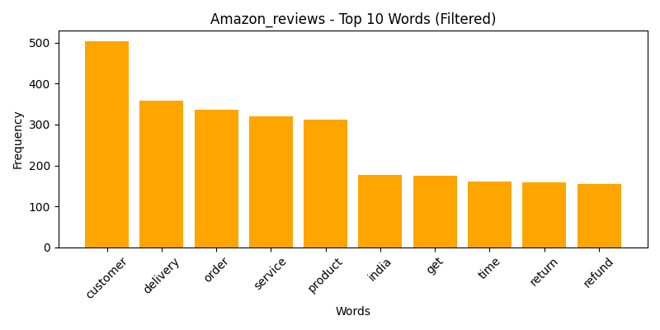
Sentiment Analysis (VADER results):
Most frequent terms: customer, delivery, order, service, product → indicate key focus areas of customer feedback
Negative experience indicators like return, refund, time suggest common complaint themes contributing to churn risk

Slide 5
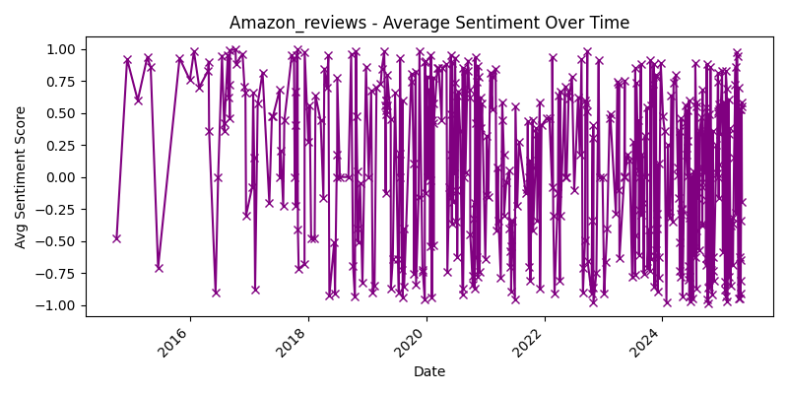
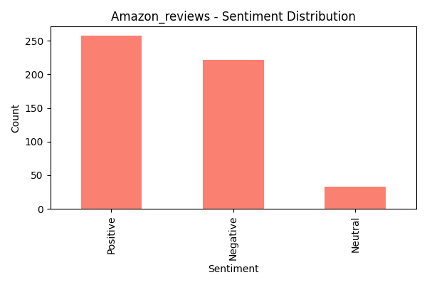
Sentiment Over Time
Sentiment scores range from -1 (negative) to +1 (positive)
Data covers 2015–2025; dynamic data updates at each run
Major dips seen around 2018 and 2023 (possible complaint surges)
Average sentiment improving by 2025 (~+0.4)
Sentiment Distribution
Total Amazon reviews analyzed: 550
Positive: 260 (47%) | Negative: 220 (40%) | Neutral: 40 (13%)
Indicates generally strong brand satisfaction
Negative reviews used to flag potential churners in modeling

Slide 6
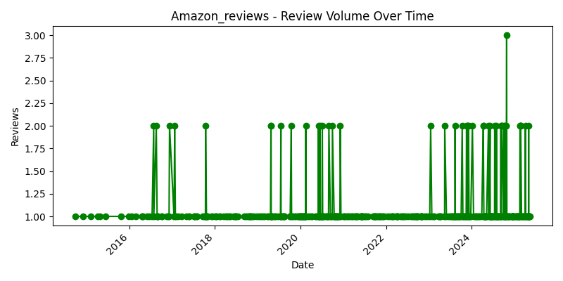
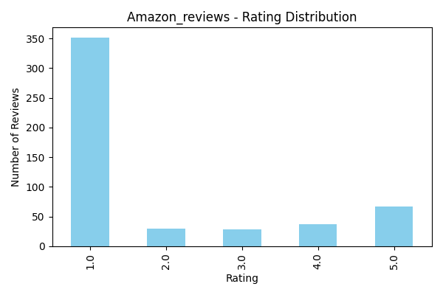
Review Volume Over Time
Data from 2015–2025, dynamically updated on each run
Spikes in review volume seen during 2020, 2023, 2025 → linked to sale events (e.g., Diwali, Big Billion Days)
Normal review rate: 1–2 per day; peak spikes reached 3 reviews/day
Rating Distribution
Total Amazon reviews analyzed: 550
1-star ratings dominate: 350 reviews (64%)
Remaining spread:
2-star → ~30 reviews
3-star → ~30 reviews
4-star → ~35 reviews
5-star → ~70 reviews
High 1-star count signals customer dissatisfaction → strong churn predictor

Slide 7
Proposed Solution:
Automates churn detection from unstructured review data
Combines review text sentiment and star ratings to predict churn risk
Uses Logistic Regression and Random Forest for prediction
Easy-to-use GUI allows non-technical users to operate the system
Benefits:-
Helps companies proactively identify unhappy customers
Supports customer service and business teams in retention efforts
Makes churn prediction accessible for small and mid-sized businesses

Slide 8
Proposed Solution:
Scrape real-time reviews from Trustpilot using Python (requests, BeautifulSoup).
Clean and preprocess data: lowercase, remove stopwords/punctuation (NLTK), assign categories via keyword matching.
Perform sentiment analysis (TextBlob/VADER) and detect sentiment-rating mismatch to label churn (1) or no-churn (0).
Convert text to TF-IDF vectors for machine learning.
Train models: Logistic Regression and Random Forest (Scikit-learn).
Evaluate performance: Accuracy, Precision, Recall, F1-score + confusion matrix.
Generate PDF report automatically with results (FPDF).
User-friendly GUI (Tkinter): end-to-end control without writing code.

Slide 9
Results and Analysis
Common Complaints:
Product defects
Delayed deliveries
Refund and return issues
Poor customer service
Sample Reviews:
"Item was fake and broken, customer support was useless."
"I placed an order, and it was cancelled twice without explanation."
"Terrible quality and completely different from product images."
"It has been 15 days, still no refund or update on my return."
"Delivery delayed by over a week. Worst experience ever."

Slide 10
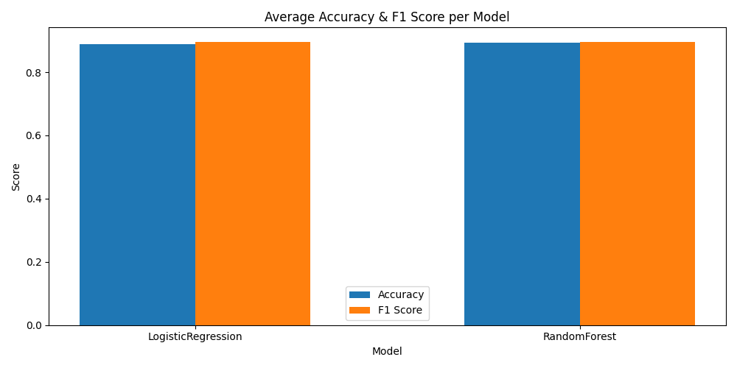
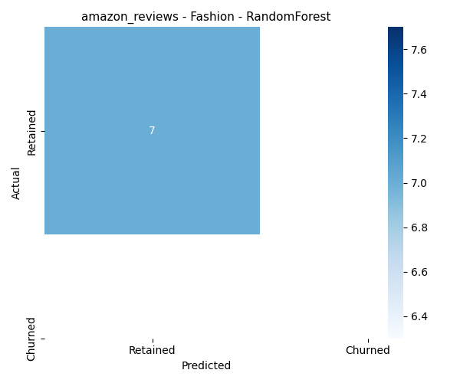
Random Forest outperformed Logistic Regression on both accuracy and F1 score
Logistic:-Accuracy = 0.90, F1 Score = 0.91
Random Forest:Accuracy = 0.91,F1 Score = 0.92
Random Forest was chosen as final production model due to superior category- level performance (up to F1 Score = 1.00 for Amazon Fashion)
Model: Random Forest
Total test samples = 7
All 7 samples were correctly predicted as Retained
True Positives (TP) = 7
False Positives (FP), False Negatives (FN), True Negatives (TN) = 0
Achieved perfect classification → Accuracy = 100%, F1 Score = 1.00
Indicates model fully learned the patterns in this category (very strong feature correlation)

Slide 11
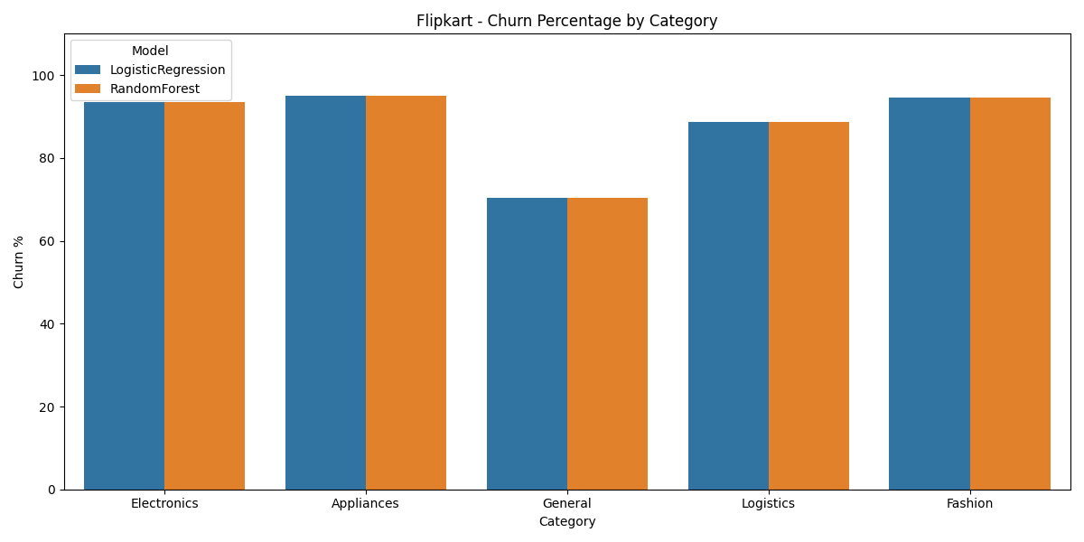
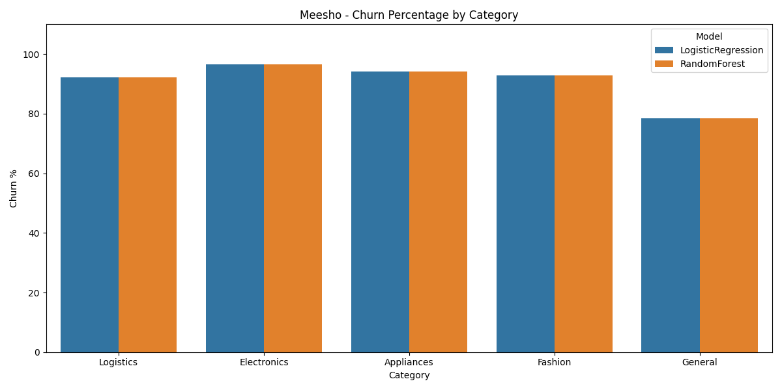
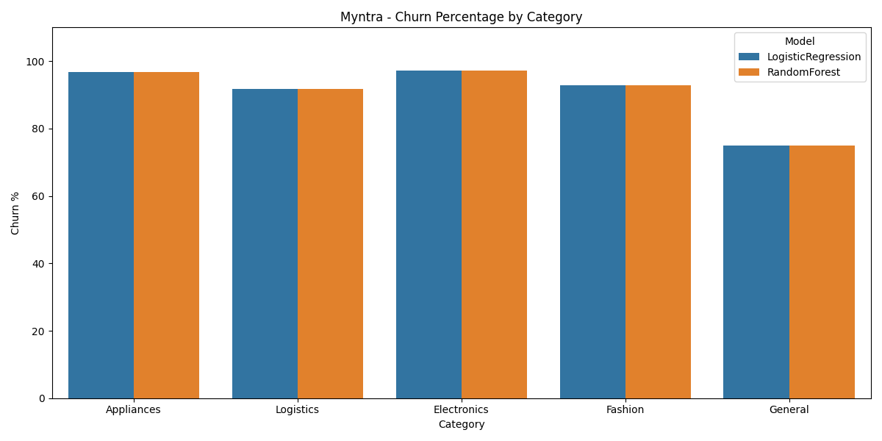
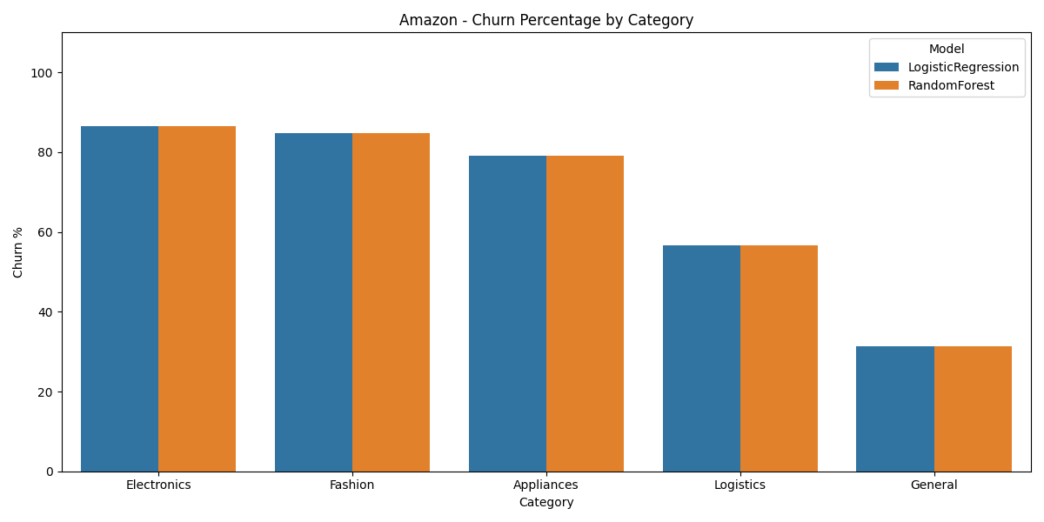

Slide 12
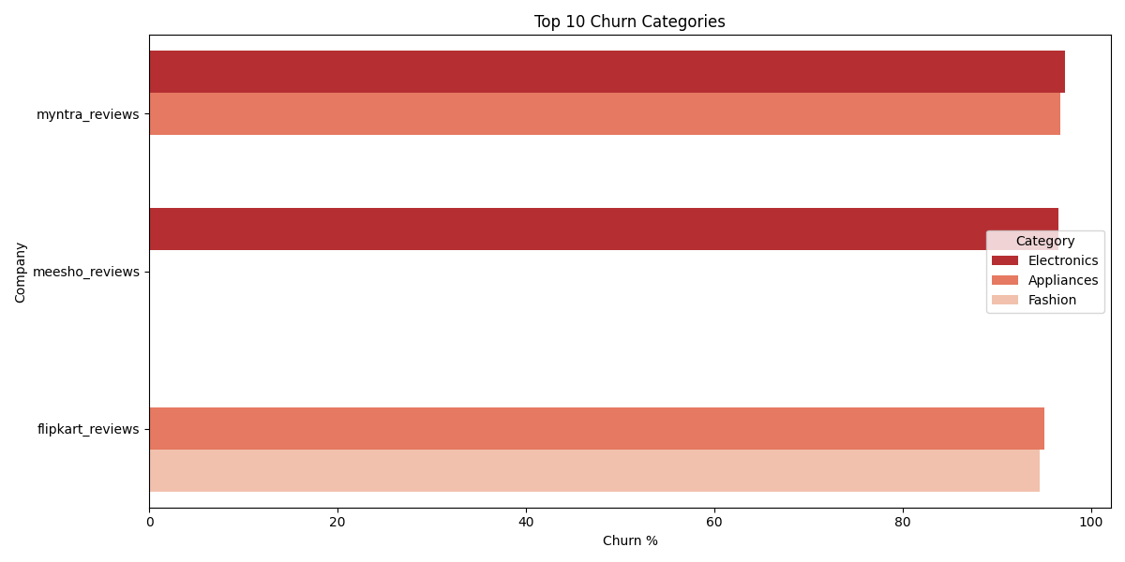
CHURN CATEGORIES
Myntra Electronics: ~98% churn
Meesho Electronics: ~98% churn
Myntra Appliances: ~97% churn
Flipkart Appliances: ~93% churn
Flipkart Fashion: ~91% churn
Insights:
Electronics had the highest churn risk across all platforms
Indicates dissatisfaction with high-value products → priority for customer retention focus

Slide 13
Conclusion:
We built a complete, automated system that predicts customer churn by analyzing live customer reviews from e-commerce platforms.
The pipeline combines data scraping, cleaning, sentiment analysis , machine learning, and automated, report generation in a seamless flow.
Our best model, Random Forest, reached perfect accuracy (F1-score 1.00) for some categories like Amazon Fashion.
GUI allowed non-technical users to analyze reviews and generate reports with a single click
System provides early churn risk insights, empowering businesses to act proactively and reduce customer loss

Slide 14
FUTURE WORK:
While the current system works well as an end-to-end churn prediction tool, there are several ways it can be further improved to meet the demands of real-world business environments:
Switch to real-time data feeds: Instead of static scraping, the system could pull live customer review data directly from platforms like Google Reviews using APIs.
Develop a web-based app: Converting the pipeline into a web application with tools like Flask or Streamlit would allow customer teams to access it easily through any browser.
Enhance text analysis with newer models: Integrating advanced natural language processing models like BERT, RoBERTa, or DistilBERT could offer much more accurate sentiment detection and even pick up complex cues like sarcasm or mixed intent.
Add support for multiple languages: This would allow the system to work with global customer bases and analyze reviews in languages other than English
Enable real-time monitoring dashboards: Connecting the analysis results to tools like Power BI or Tableau could help businesses continuously track churn risk and respond instantly to new trends.

Slide 15
REFERENCES
Verbeke, Wouter, et al. "Predictive Modeling with Big Data: Is Bigger Really Better?" Big Data, vol. 2, no. 2, 2014, pp. 105–113.
Pang, Bo, and Lillian Lee. "Opinion Mining and Sentiment Analysis." Foundations and Trends in Information Retrieval, vol. 2, no. 1-2, 2008, pp. 1–135.
Zhang, Xiaoyan, et al. "A Deep Learning-Based Approach for Customer Churn Prediction Based on Customer Reviews." IEEE Access, vol. 8, 2020, pp. 152017–152030.
Ghosh, Rahul, et al. "Customer Feedback Analytics Using Text Mining and Sentiment Analysis: An Application to the Indian Telecom Industry." Journal of Retailing and Consumer Services, vol. 57, 2020, article 102220.
Jindal, Nitin, and Bing Liu. "Opinion Spam and Analysis." Proceedings of the 2008 International Conference on Web Search and Data Mining (WSDM), ACM, 2008.

Slide 16
REFERENCES
Văduva, Alin-Gabriel, Simona-Vasilica Oprea, and Dragoș-Cătălin Barbu. "Understanding Customers' Opinion Using Web Scraping and Natural Language Processing." Ovidius University Annals, Economic Sciences Series, vol. 23, no. 1, 2023, pp. 537–544. ResearchGate.
Li, Ang, et al. "Utilizing Data Science and AI for Customer Churn Prediction in Marketing." Journal of Telecommunications and the Digital Economy, vol. 4, no. 5, 2024, pp. 1–15. Century Science Publishing.
Wu, Qianye, Chengxuan Xia, and Sixuan Tian. "AI-Driven Sentiment Analytics: Unlocking Business Value in the E-Commerce Landscape." arXiv preprint, arXiv:2504.08738, Mar. 2025.
Pangarego, R. "Case Study: E-Commerce Customer Churn Analysis and Prediction Using Python." Medium, 2023.
PromptCloud. "E-Commerce Sentiment Analysis: Web Scraping for Reviews and Ratings." PromptCloud Blog, 2023.
Khattak, Asad, et al. "Customer Churn Prediction Using Composite Deep Learning Technique." Scientific Reports, vol. 13, no. 1, 2023, article 17294. Nature.

Slide 17



